Slide 1


Three Horizons
Supporting better quality health and social care for everyone in Scotland

Slide 2
Aims of the day
By the end of today you will have:
Discussed common aims/objectives
Heard insights from across the system
Developed an understanding of how you might contribute to change

Slide 3
Agenda
Time | Title
13:20 – 13:30 | Welcome and Introduction
13:30 – 14:00 | Where we are and what we know
14:00 – 14:30 | Intelligence sharing
14:30 – 14:45 | Comfort Break
14:45 – 15:30 | Discussion: Three Horizons
15:30 – 15:45 | What else do we want to know?
15:45 – 16:00 | Next Steps and Close

Slide 4
Interconnected System Map
Notes:
Overview of ISM

Slide 5
Where we want to get to

Slide 6
Discussion One: Intelligence sharing
Briefly outline:
Current operational priorities
Key learning from the last year
Ongoing partnerships
Think about:
How does this resonate with you?
Does this address a gap you have?
How does this

Slide 7

Break

Slide 8

Discussion Two: Three Horizons
What is it for?
Framework for understanding change within complexity
Embracing the ‘messy middle’
“Don’t let perfection be the enemy of good”
What are the Three Horizons?
H1 Business as usual
H2 Innovation/Switching Lens
H3 Visionary (Future)

Slide 9
Discussion Two: Three Horizons
Where are we in [name of area]
Horizon One:
List key points of where the current system is
Horizon Three:
List key points of where you would like the system to be

Slide 10
Discussion Two: Three Horizons
Towards the Second Horizon:
Innovations in play – How are we already changing?
What changes are we developing over the coming year or so?
What are the opportunities to adopt or take advantage of changes?
What is within our scope of practice?

Slide 11
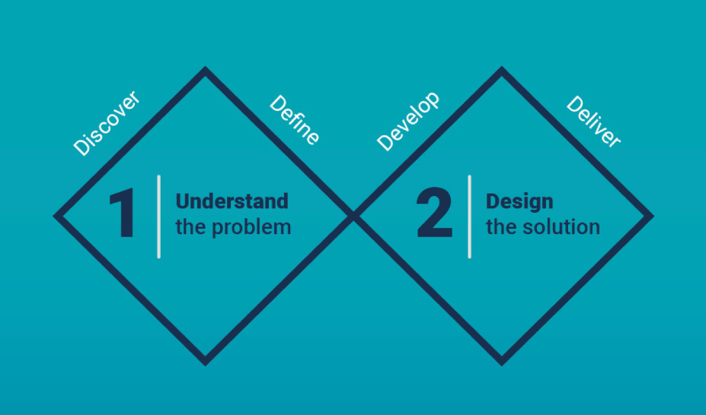
Next steps
Defining the focus:
Interviews
Journey mapping
Analysis and findings report
From understanding to designing:
How might we…?
Outlining change ideas
We are here

Slide 12
Keep in touch
Twitter: @online_his
Email: comments.his@nhs.scot
Web: https://www.healthcareimprovementscotland.scot
Blog: blog.healthcareimprovementscotland.org
Supporting better quality health and social care for everyone in Scotland

