Slide 1
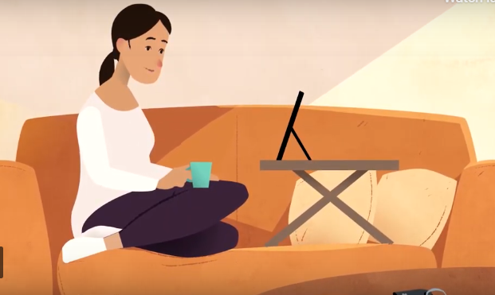
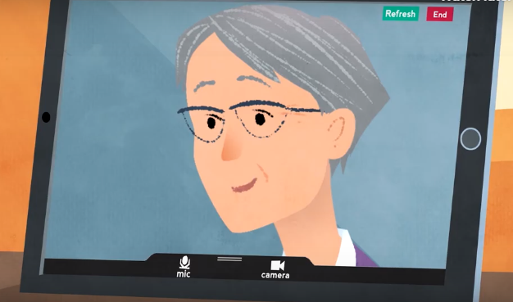
Near Me: public engagement the benefits, the barriers and the surprises

Slide 2
Overview
Background
Covid-19
Public engagement and Impact Assessment
Key findings
Discussion

Slide 3
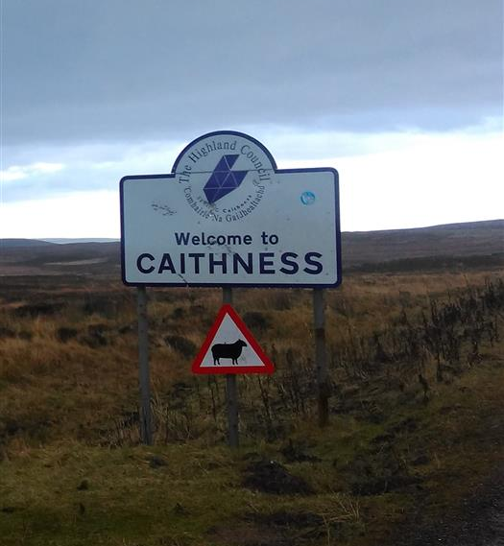
2017 Background

Slide 4
Professor Trisha Greenhalgh – March 2020
“Virtual consultations have often been considered in terms of convenience or patient and staff preferences, but now they are a necessity.”

Slide 5
March 2020
“Suddenly the relative advantage of virtual consultations has changed dramatically.”
Professor Trisha Greenhalgh
(March 2020)

Slide 6
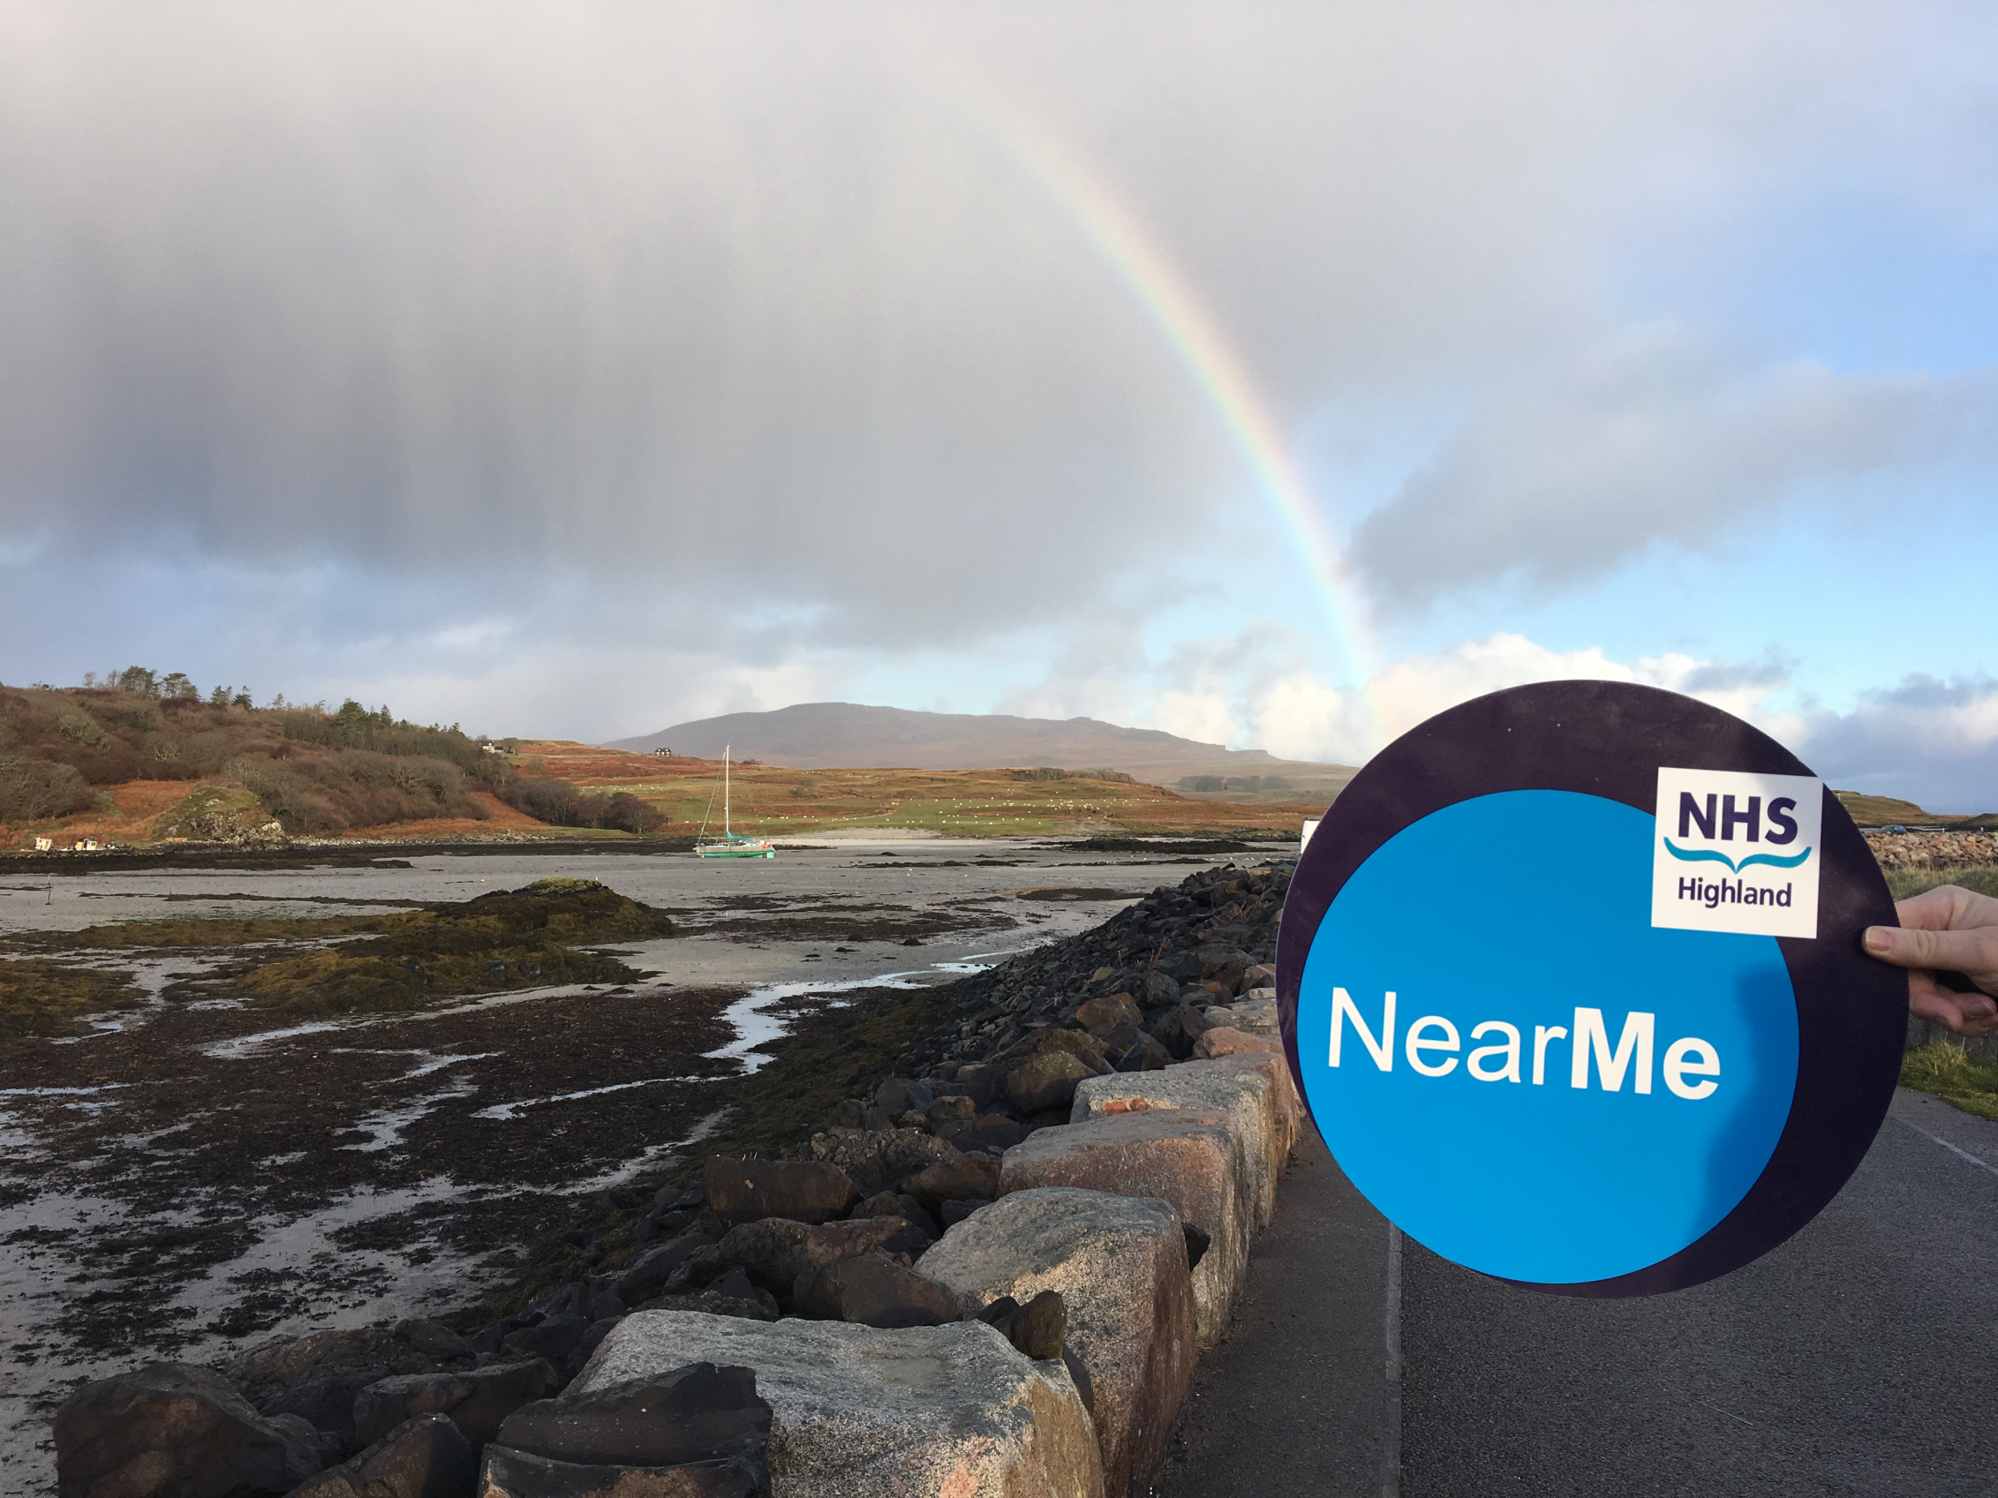
Why a public engagement and EQIA?
17 Sept 2020

Slide 7
Objectives
Understand benefits and barriers
Understand views of people who had never used Near Me
Co-produce an Equality Impact Assessment and gain insight into potential exclusions
Identify improvements
Raise awareness

Slide 8
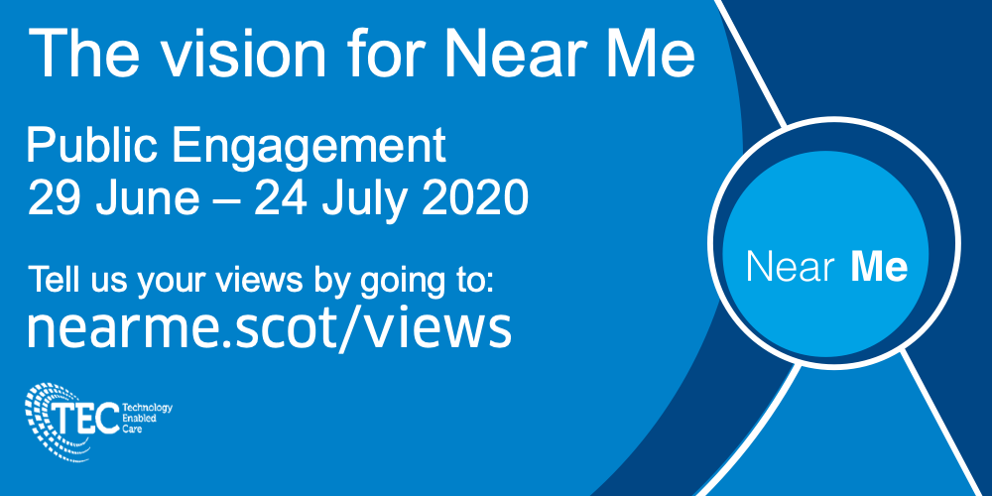
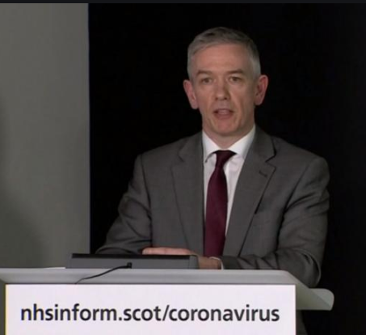

Slide 9
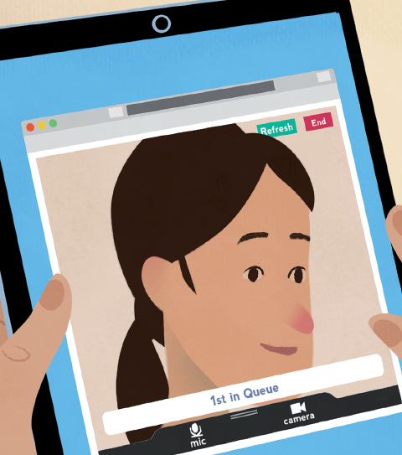
Key findings

Slide 10
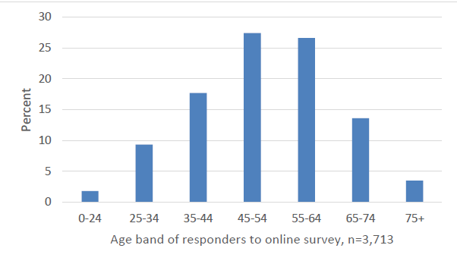
Public respondents
Age band
81% female
18% disability
97% white
All NHS boards

Slide 11
Health professional respondents
Care setting
Profession

Slide 12
Engagement
5,400 responses

Slide 13
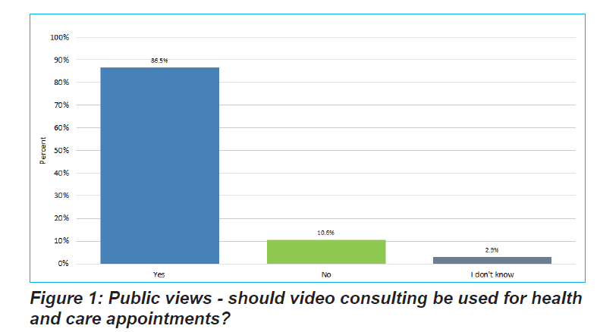
Should video be used? Public

Slide 14
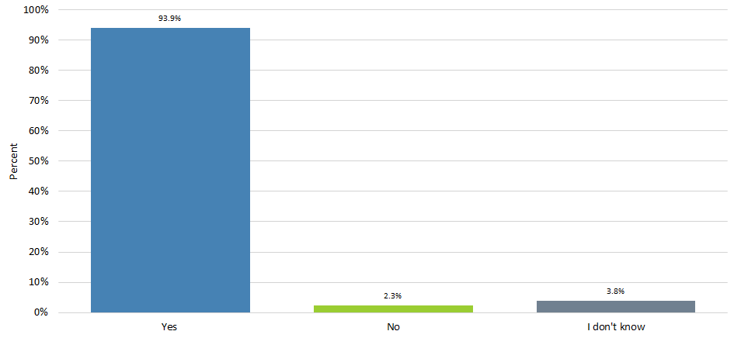
Should video be used? Clinician

Slide 15
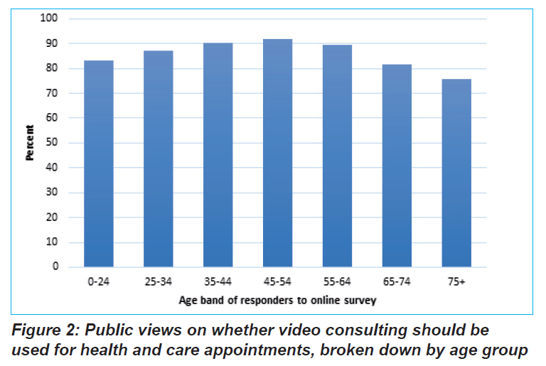
Public: Age breakdown

Slide 16
Should video be used? By Disability

Slide 17
Would benefit from support

Slide 18
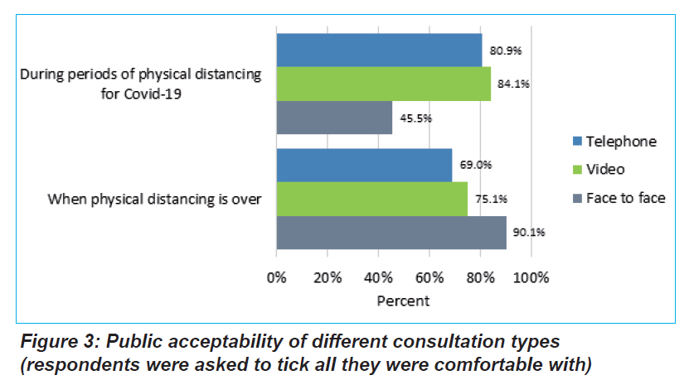
Key findings

Slide 19
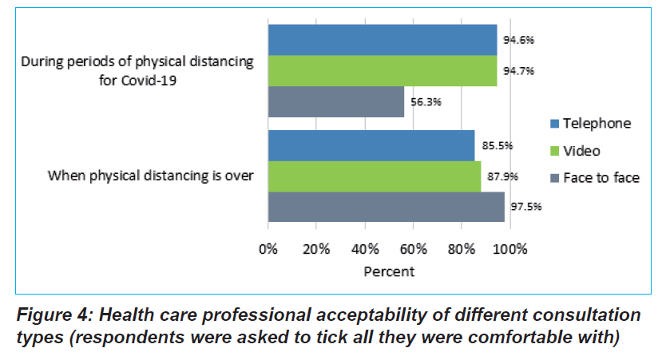
Key findings

Slide 20
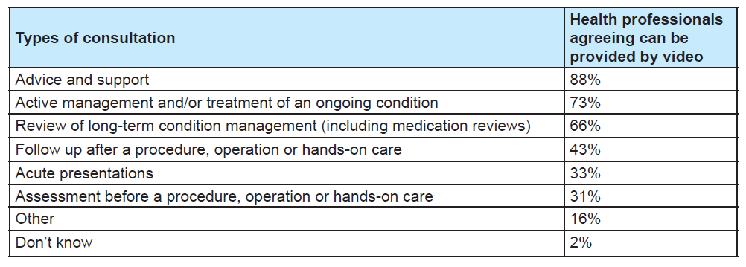
Types of consultation

Slide 21
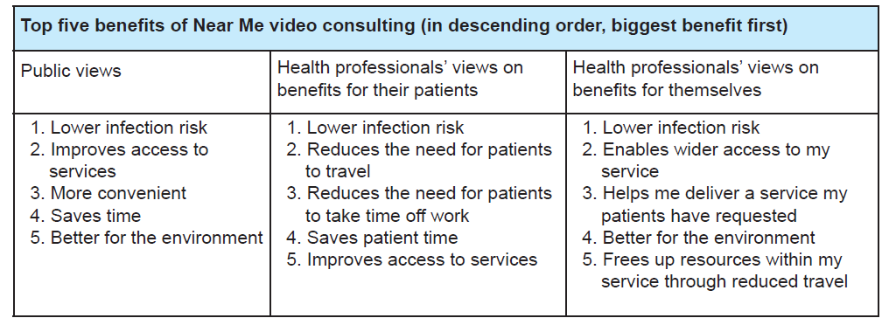
Benefits

Slide 22
Barriers

Slide 23
Equality Impact assessment Summary of barriers
Clinicians or organisations make assumptions about video appointments not being appropriate
Lack of a safe and confidential space to conduct a video appointments
People who are digitally excluded for whatever reason

Slide 24
Making it easier:
Improve digital access including connectivity
Introduce or expand local hubs or community-based borrowable devices
Ensure choice over how consultations are provided
Improve patient information and best practice guidance from professional bodies
Notes:
Leads nicely into the EQIA…

Slide 25
Discussion
Q&A

