Slide 1
Participatory public engagement in digital health and care: moving beyond conventional engagement methods
Sonja Erikainen, Nicola Boydell, Nayha Sethi, & Ellen Stewart, Centre for Biomedicine, Self and Society, University of Edinburgh

Slide 2
Overview
Background and context
Our study
Understanding participatory public engagement
Key things to consider before choosing and using participatory engagement methods
Participatory engagement methods: five families
Mini-publics methods
Public oversight and monitoring methods
E-democracy and crowdsourcing methods
Workshop and dialogue methods
Arts based and game play methods
Conclusions

Slide 3
Background and context
Scotland’s 2018 Digital Health and Care Strategy is grounded in a vision for every Scottish resident that:
“‘I have access to the digital information, tools and services I need to help maintain and improve my health and wellbeing. I expect my health and social care information to be captured electronically, integrated and shared securely to assist service staff and carers that need to see it… …and that digital technology and data will be used appropriately and innovatively:
to help plan and improve health and care services,
enable research and economic development,
and ultimately improve outcomes for everyone.”
Public engagement is a well-established dimension of the activities of governments and public sector organisations across the world
Scottish Government has significant existing commitments to develop and support public engagement, e.g…
The Open Government Partnership
Participation Framework
Scottish National Standards for Community Engagement

Slide 4
Our study
Aimed to…
Explore and inform innovative participatory approaches to public engagement that can be used by the Scottish Government to move beyond conventional engagement methods in the policy area of digital health and care.
What participatory methods can be used by the Scottish Government to engage with publics especially around digital health, and to reach wider and more diverse publics?

Slide 5
Our study
Rapid knowledge synthesis
Scoping conversations with 14 engagement specialists and academic experts, to identify examples of good practice and innovation in participatory public engagement
Rapid literature review of academic and grey literature
Evaluation of identified methods, through assessing…
what aims can the methods be used for, and have projects using the method achieved their aims?
what kind and level of participation do the methods enable?
how can people participate through the methods?
what influence or impact can the method have?

Slide 6
Our study
Key limitations
Scope restricted – included a limited number of sources due to restricted timeframe
should be seen as a scoping exercise, not as a comprehensive representation of the entire complex landscape of participatory public engagement

Slide 7
Understanding participatory public engagement
There is an abundance of knowledge, experience and expertise in participatory public engagement within and beyond Scotland...
…but consolidating learning is frequently hampered by lack of cross-sector working, and notions of ‘exceptionalism’.
perceptions that issues relating to health (including digital health and care) are different to other sectors, and therefore lessons from other sectors are not considered to be directly transferable.
The current landscape of participatory public engagement is rich but ‘cluttered’
While there is a wealth of knowledge to be harnessed, a key challenge lies in bringing this knowledge together in a usable way.
How can the wealth of existing knowledge be harnessed effectively to address governance issues and challenges around digital health and care?

Slide 8
Understanding participatory public engagement
What is “participatory”?
Malleable and ambiguous concept, used in many different ways
To differentiate types and levels of participation, many have proposed typologies, e.g…
Arnstein’s (1969) ladder of participation
White’s (1996) typology of interests
We built on both Arnstein and White’s typologies, and generally included methods that ranked highly across both…
…and organised them into a framework adopted from Fung’s (2006) categories of participation, focusing on: aims used for, level of participation, manner of participation (how), influence or impact

Slide 9
Understanding participatory public engagement
What is “public”?
From singular uses of ‘the public,’ towards plural ‘publics’
publics are not a singular entity with a unified a unified perspective but a collection of diverse individuals and groups with different backgrounds and views
Full participation by all publics is usually impossible in practice
Cornwall (2008) – more feasible and realistic is to focus on optimum participation
balance between degree of participation and inclusion of the most appropriate participants in relation to the aims of each engagement activity

Slide 10
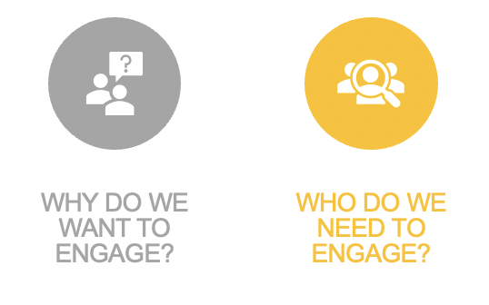
Things to consider before choosing and using participatory engagement methods
INITIAL QUESTIONS TO ANSWER…
Initial questions to answer:
Why do we want to engage?
Who do we need to engage?
What resources are available for engagement?
What impact and learning do we want to achieve?
How will we evaluate engagement?

Slide 11
Things to consider before choosing and using participatory engagement methods
Extend to public engagement activities, constraining the extent to which people can participate, or preventing participation
Barriers are specific to context, and highly variable – there is no singular way to overcome all of them
Inclusive engagement is generally a multifaceted and multistage process, with several measures taken at the same time
Barriers to participation
Most barriers are connected to social and structural inequalities within wider society…
…but also include issues such as lack of confidence, feeling that participation is futile, or previous experiences that may cause people to self-exclude.

Slide 12
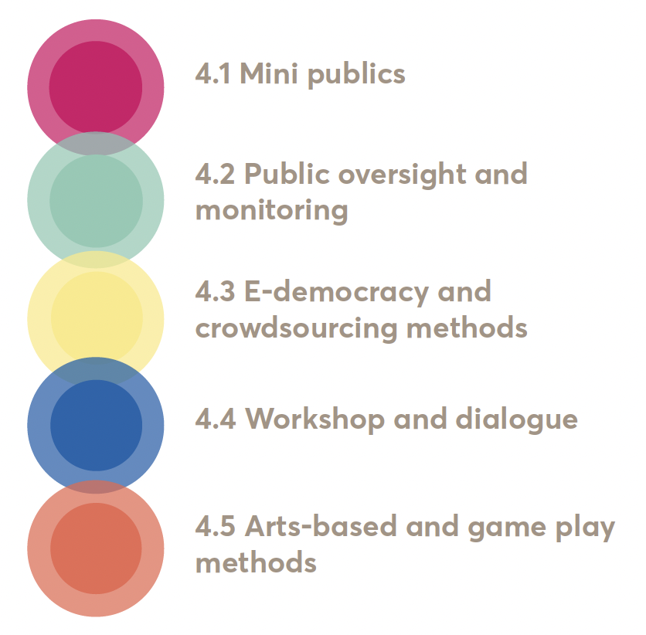
Participatory public engagement methods: Five families
‘Families’
= captures the idea of ‘family resemblance’; shared family characteristics, even while individual methods are unique
But… the different families are not mutually exclusive – families identify overarching differences and distinguishing features, but are overlapping, and individual methods can combine features across them.

Slide 13
Mini-publics
What are mini publics? | Group of randomly selected, demographically representative people engage in informed deliberation, generally to reach a consensus
What are examples of mini publics methods? | Citizen juries, citizen panels, citizen assemblies, citizen summits, consensus conferences
What aims are mini publics most suited to? | Engagement activities requiring informed deliberation and aiming to arrive at a consensus
At what stage are mini publics most useful? | During the plan or policy formulation stage of the decision-making process
Who generally participates in mini publics? | Randomly selected members of publics who are chosen to be representative of a population
What scale are mini publics most suited to? | Generally small (10-30) to medium (50-250) scale depending on the specific method, but sometimes 500 to over 1000 participants can be involved
What are the limitations of mini publics methods? | Achieving a representative sample of participants is complex and can be challenging; reaching a consensus may be difficult; mini public often require high degree support, commitment and buy-in

Slide 14
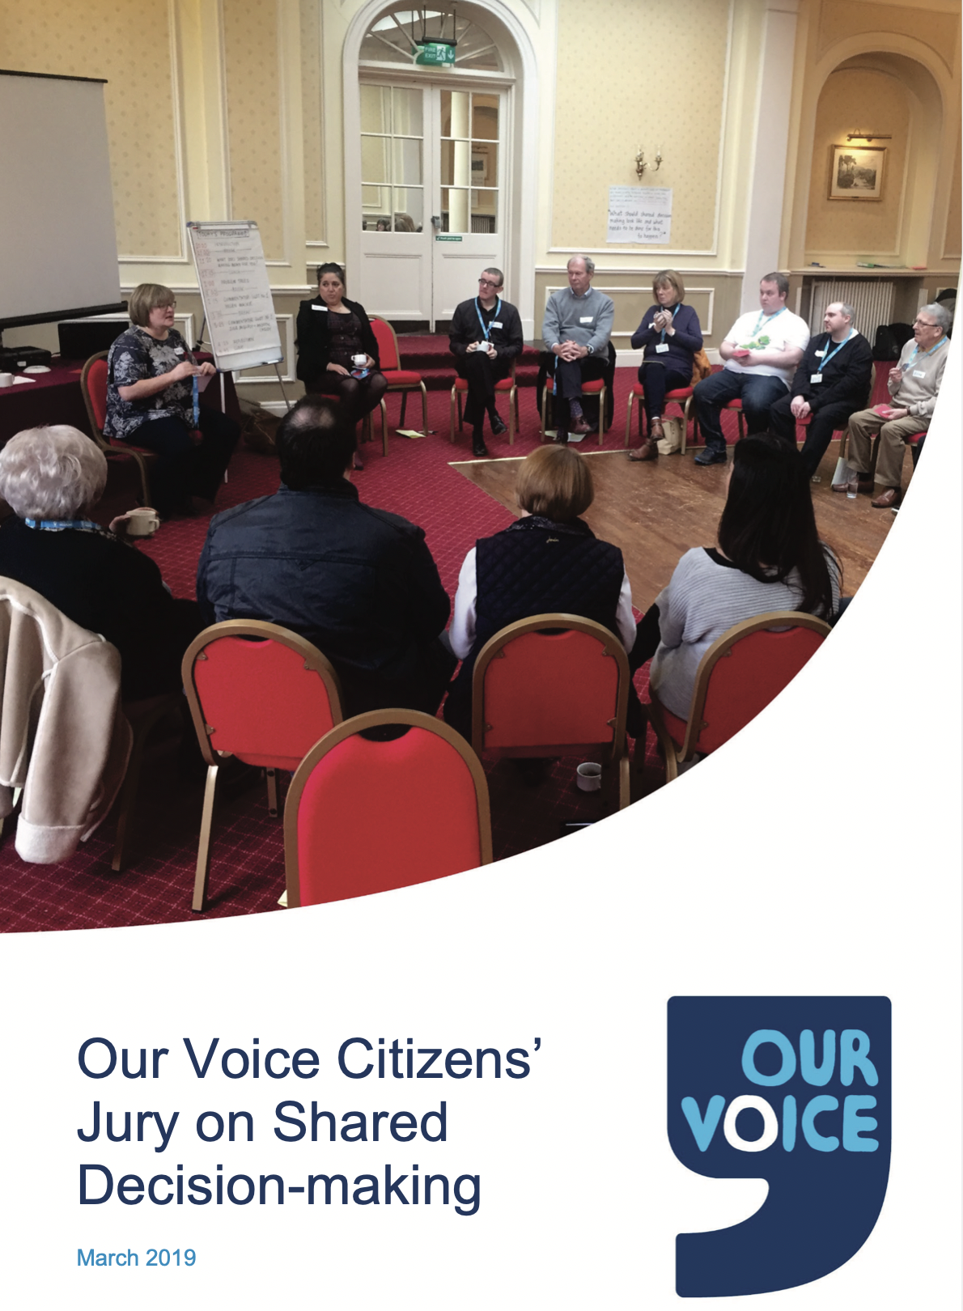
Mini-publics example: Our Voice Citizen’s Jury on shared decision-making, Scotland
Key aim: deliberate and generate a set of collectively agreed recommendations on shared decision-making in health and social care
Citizen jury including 24 randomly selected participants
Generated 13 recommendations presented to Chief Medical Officer and stakeholders, and the Scottish government committed to taking 12 of the recommendations forward

Slide 15
Public oversight and monitoring methods
What are public oversight and monitoring methods? | Members of publics monitor or have oversight over implementation or delivery of public services, e.g. assessment, feedback, improvements
What are examples of public oversight and monitoring methods? | Community monitoring, citizen advisory boards, citizen- or community- auditing, community score cards, participatory evaluation
What aims are public oversight and monitoring methods most suited to? | Activities where the aim is to monitor the implementation of an activity or evaluate its success
At what stage are public oversight and monitoring methods most useful? | Implementation or delivery and evaluation stages of the decision-making process
Who generally participates in public oversight and monitoring methods publics? | Various participant recruitment approaches can be used, but generally self-selecting volunteers, often from community organisations
What scale are public oversight and monitoring methods most suited to? | Scale is variable, but generally small (5-30) or medium (up to around 300) scale depending on the specific method
What are the limitations of public oversight and monitoring methods methods? | Participation can be time intensive and may require investment in training in and development of new skills; can involve multiple stages that can become complex and challenging to administer

Slide 16
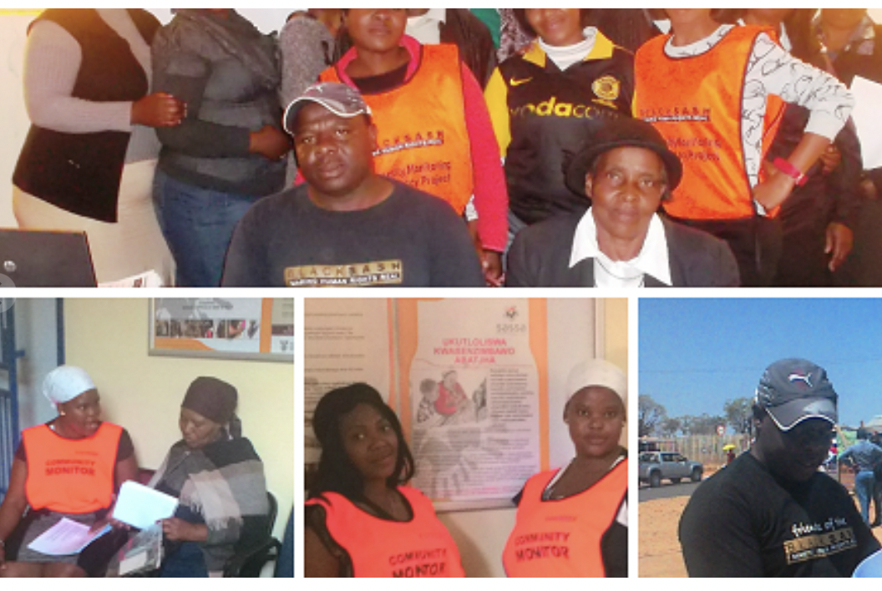
Public oversight and monitoring example: Black Sash Making All Voices Count Community-based monitoring, South Africa
Key aims: give community-based organisations ownership and active participation in citizen-based monitoring of government services, and encourage citizens to appraise public services
Black Sash seven stage community-based monitoring model where over 100 members of local communities acted as monitors, e.g. by undertaking surveys of people accessing service delivery sites
Generated improvement action plans for monitored services and sites, in some cases improvement committees, and a large-scale advocacy campaign

Slide 17
E-democracy and crowdsourcing methods
What are e-democracy and crowdsourcing methods? | Using participatory digital tools to facilitate publics’ active participation in governance processes and decision-making
What are examples e-democracy and crowdsourcing methods methods? | Mostly include participatory digital democracy and crowdsourcing platforms, many incorporating participatory budgeting elements
What aims are e-democracy and crowdsourcing methods most suited to? | Activities aiming to identify problems or generate ideas and solutions, and activities that aim to prioritise ideas or proposed activities
At what stage are e-democracy and crowdsourcing methods most useful? | Problem identification, agenda setting, and idea and solution generation stages, and during idea prioritisation or priority setting
Who generally participates in e-democracy and crowdsourcing methods publics? | Most useful when open to general publics, but in practice those who participate tend to be self-selecting individuals wanting to be involved because they have ideas or priorities to share
What scale are e-democracy and crowdsourcing methods most suited to? | Large-scale, involving thousands or tens of thousands, but can also be usefully applied at medium scale, involving hundreds of participants
What are the limitations of e-democracy and crowdsourcing methods methods? | Prone to practical challenges around functionality, useability and accessibility of digital platforms; require a high degree of support, commitment and buy-in from decision-makers

Slide 18
E-democracy and crowdsourcing example: Better Reykjavik, Iceland
Key aims: crowdsource, debate, and prioritise ideas for improving the city of Reykjavik, directly from residents
Using the digital Your Priorities platform for direct democratic participation – all residents can post or vote on improvement ideas
Generated high level engagement – approximately 10,000 ideas and 12,000 responses, and approximately 800 resident-initiated projects have been implemented since launch.

Slide 19
Workshop and dialogue methods
What are workshop and dialogue methods? | Versatile and diverse methods based around intensive, often facilitated, discussion on a topic, or around spoken group dialogue
What are examples workshop and dialogue methods methods? | World cafes, futures and scenario workshops, deliberative workshops, talking circles, focus groups, interviews
What aims are workshop and dialogue methods most suited to? | Because they are versatile, they can be adapted and applied to suit a wide range of different aims
At what stage are workshop and dialogue methods most useful? | Because they are versatile, they can be adapted and applied to suit any stage of the decision-making or policy process.
Who generally participates in workshop and dialogue methods publics? | Who participates varies greatly, and many different participant recruitment and selection methods can be used
What scale are workshop and dialogue methods most suited to? | Small-scale engagement, involving 5-30 participants.
What are the limitations workshop and dialogue methods methods? | Versatility and diversity can create lack of clear direction or rules for designing activities. Without careful planning and investment, the high level of flexibility can also compromise rigour and effectiveness.

Slide 20
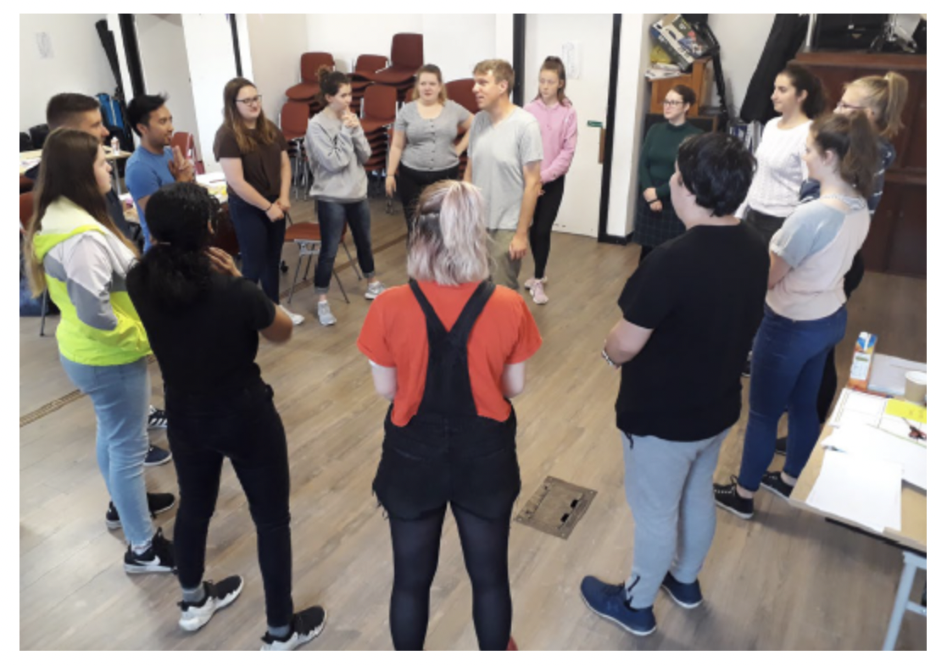
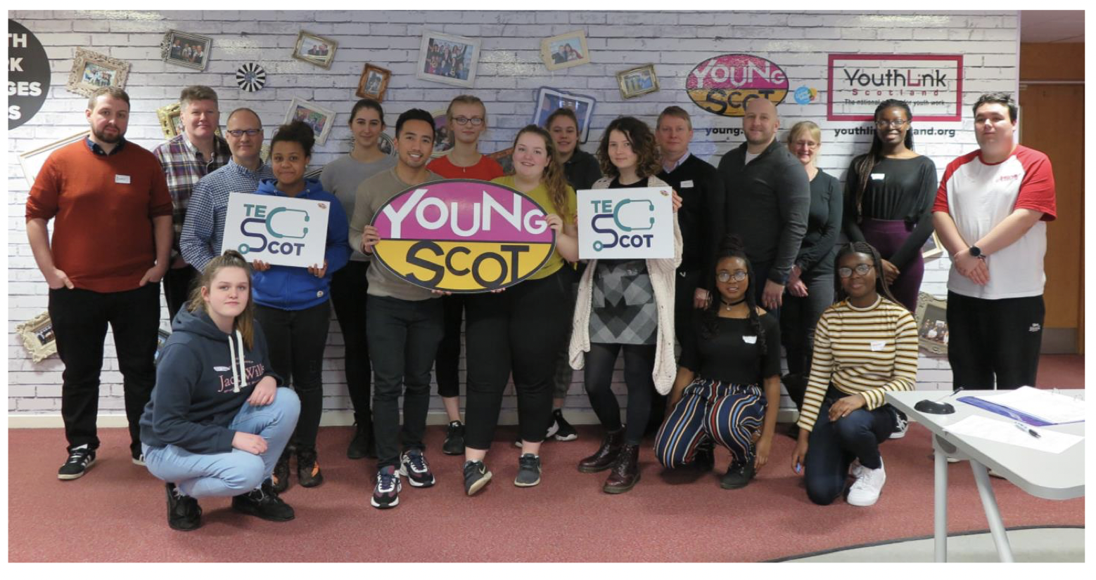
Workshop and dialogue example: Young Scot Technology Enabled Care Workshops, Scotland
Key aims: to engage young people to consider how and why they use digital technologies, and how digital technologies could be used to improve their health and wellbeing
A series of four workshops with 36 young people total, to identify priorities, generate ideas, and synthesise and refine priorities and ideas
This was part of, and shaped and informed, a wider programme of youth engagement, including creation of the TECScot national Strategic Participation Panel of young people

Slide 21
Arts based and game play methods
What are arts based and game play methods? | Versatile and diverse methods based around the use of art or game play as media for participatory public engagement
What are examples arts based and game play methods? | Fine/performance arts, photography, film, music, storytelling, board games, role play, computer games, exhibitions, installations
What aims are arts based and game play methods most suited to? | When used on their own, to educate, inform, or influence views. When used with other methods, can be adapted to suit a range of aims
At what stage are arts based and game play methods most useful? | When used on their own, outreach or education. When used with other methods, can be adapted to suit any stage of decision-making
Who generally participates in arts based and game play methods publics? | Who participates varies greatly, and many different participant recruitment and selection methods can be used
What scale are arts based and game play methods most suited to? | The scale varies greatly. Can be applied at any scale depending on the specific method, activity or initiative
What are the limitations arts based and game play methods methods? | Versatility and diversity can create lack of clear direction or rules for designing activities. Without careful planning and investment, the high level of flexibility can also compromise rigour and effectiveness; tend to be more difficult to translate into policy impact or action.

Slide 22
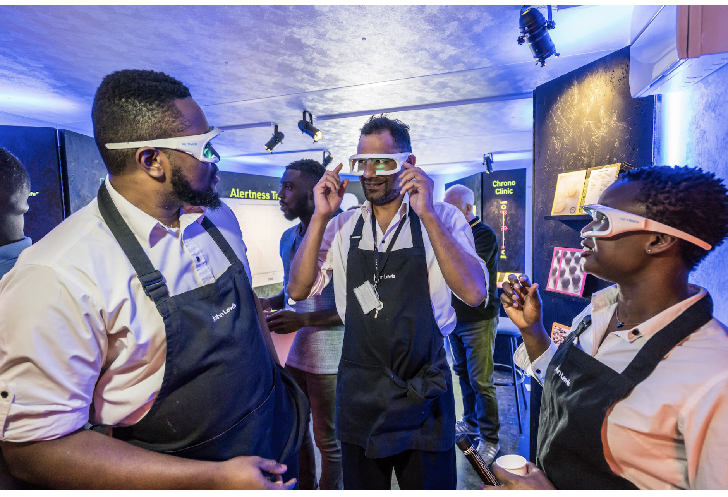
Arts based and game play methods example: The Liminal Space Night Club Installation and Engagement Programme, UK
Key aims: to improve night shift workers’ sleep health, increase knowledge and induce behaviour changes, induce corporate partners to make systematic and structural changes to improve workers’ health
Approximately 3,250 workers engaged with interactive walk in installations at the workplace, and facilitated group and one-on-one discussions
Participants’ sleep health knowledge increased and they made changes to their behaviours, and all corporate partners made some changes, some more substantially than others

Slide 23
Conclusions
There is no singular example of ‘best practice’ in participatory public engagement
what successful activities look like varies and depends on numerous factors, like if and how the aims were achieved, how participants were selected and why, what the desired impact was and whether it was realised
Digital health and care may require some special considerations, but they are not necessarily exceptional – lessons from other sectors are and should be acknowledges as transferable
Suitable methods depend on why engagement is undertaken, who it is undertaken by and with, what resources are available, and what the outcomes and impact are envisioned to be, which also need to be evaluated
Neither participatory public engagement, nor the identification of appropriate methods for engagement, should become box ticking exercises

Slide 24
Thank you!

