Slide 1
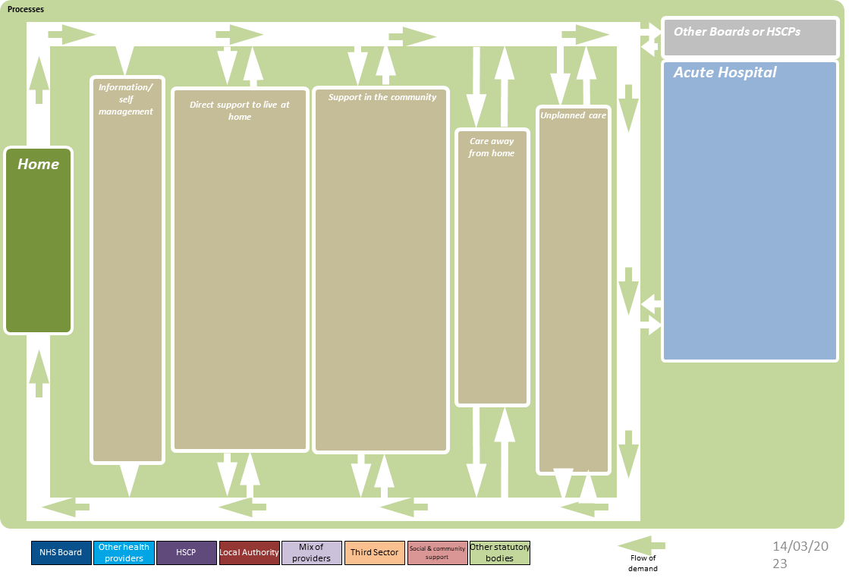
Heath and Social Care System – North Lanarkshire
Created by Strategic Planning Portfolio, ihub, Healthcare Improvement Scotland.
Barnardos
GP
Breathing space
GP Health Hubs
Alcoholics Anonymous
LANDED
Advocacy
Lanarkshire Links
Health & Homelessness Service
Community MH Services
A&E Navigators
Punumbra
Carer’s orgs
A&E
Samaritans
Harm Reduction Team
Addiction GP Team
Blue Triangle
Community Boards
LAMH Café and Wellbeing Centre
Childline
Chris’ House
Mens Shed
North Lanarkshire Carers
Helplines
Acute Substance Misuse
Citizen’s Advice
Addiction recovery team
Home Care Support
GP Community Link Worker
Homestart
Murdostoun Castle
Wishaw Hospital Navigators
Community Addiction Teams
Shelter Scotland
Community Mental Health Teams
Men's Shed
Calderglen House, Rehab
Blue Triangle Accommodation Support
North Lan. Recovery Community
Distress Brief Intervention Programme
Recovery Scotland – Recovery Cafe
Turning Point
Community pharmacies
Residential Rehab (Hospital Stay)
Smart Recovery
NHS L. Domestic Violence Team
Community Hubs
SAMH
Buchanan Street Children’s ad Adult’s Residential House
Housing Support Team
Faith Groups
Criminal Justice Services
SHELTER
Mind Matters
SSAFA
Police Scotland
The Beacons
Primary Care Services
Rapid Rehousing Team
North Lanarkshire Overdose Response Team
Commissioned House Support
NL Community Connectors Imitative
NL Carers Together
Support Groups
Cumbernauld and Carbain Community Hub
Advocacy Care and Addiction project
Positive Support Addiction Service
Key Housing Service
We Are With You
Women’s Aid
Barnardo’s Youth Housing Support Service
Simon Community
Action for Children NL Young Carers Service
Sliverline
Getting better together
PHEW
Breathing Space
Addictions Recovery Team (ART)
Homeless prevention activity
National Debt Helpline
Recovery Groups
Home Care
NHS 24
CMHT
Phoenix Futures
Family Plus Service
Community Alarm Service
SOL Support for Ordinary Living
Social Work Out of Hours
Voluntary Action
CLD Home Link Worker
Turning Point
MH Services
Lanarkshire Overdose Response Team
Women’s Outreach Team
Out of Hours Homeless Services
Social Media
Housing First
Other

