Slide 1
Thinking like a system in planning
Callum Alexander, Clare Hammond, Gregory Hill-O’Connor
Transformational Change – Systems Unit
Community Engagement and Transformational Change Directorate
Leading quality health and care for Scotland
NB: This webinar is being recorded

Slide 2
Welcome and introductions
Callum Alexander, Clare Hammond, Gregory Hill-O’Connor
Transformational Change – Systems Unit
Community Engagement and Transformational Change Directorate
Leading quality health and care for Scotland

Slide 3
This session is being recorded

Slide 4
Questions you have

Slide 5
Agenda
Why think like a system?
What is systems thinking?
Examples in action.
A few things to note.
Applying systems thinking in your role.
What next?

Slide 6
Why think like a system?

Slide 7
Why think as a system?

Slide 8
Why think as a system?
Solution
Problem

Slide 9
Why think as a system?
Change sought
Accidentally undermining change

Slide 10
Why think as a system?

Slide 11
Why think as a system?

Slide 12
Going in the same direction?

Slide 13
Going in the same direction?

Slide 14
System responds to where you press

Slide 15
System responds to how you fund it

Slide 16
We build our system
Decisions
Indecisions
Consequences

Slide 17
We build our system

Slide 18
What is systems thinking?

Slide 19
Definition of a system
More than one part

Slide 20
Definition of a system
Interactions between parts

Slide 21
Definition of a system
Emergent properties

Slide 22
Definition of a system
Addictions support
Community mental health
GP surgery
Community justice
Housing support

Slide 23
Definition of a system
Knowledge shared
Shared views
Coordination of care
Aligning processes

Slide 24
Definition of a system
Escalation prevented
Trauma informed care
Trusted person coordinating
Additional access
to care
Gaps closed

Slide 25
Definition your boundary
THE COMPONENTS OF THE SYSTEM
SYSTEM BOUNDARY
SYSTEM CONTEXT OR ENVIRONMENT

Slide 26
Definition your boundary
WHICH IS THE SYSTEM?
…IT DEPENDS ON WHAT YOU ARE TRYING
TO ACHIEVE

Slide 27
Structures and behaviours of a system
THE STRUCTURE OF A SYSTEM
THE BEHAVIOUR OF A SYSTEM

Slide 28
Cause and effect within a system

Slide 29
Feedback loops
Chickens
Eggs
+
POSITIVE OR REINFORCING FEEDBACK
R
+
-
NEGATIVE OR BALANCING FEEDBACK
B
+
Chickens
Roads

Slide 30
Feedback loops
R

Slide 31
Knock on effects
Wait times
Case escalation
+
+
+
GP appointment demand
Overall demand

Slide 32
Examples in action

Slide 33
Dundee care for older people
Enhanced care in home
Home
Reablement
Care at home
Hospital
Discharge to assess
Care home

Slide 34
Mental health and substance use
Out of Hours GP
Children and families social work
Alcohol and drug services
Primary Care
Social work
Psychology
999
Housing and homelessness services
Urgent and emergency mental health service
Community Mental Health
Pharmacy
Criminal Justice
Inpatient unscheduled care admissions

Slide 35
Unscheduled care
Reasons people access unscheduled care
The only way to create long term sustainability in unscheduled care is to better address the drivers of demand through investing well in services outwith unscheduled care.
1
Sudden accident or illness
2
Frailty, palliative and long-term conditions
3
Multiple disadvantage
Unpaid Carers
Alcohol drug
Primary Care
Elective care
Mental health
Social care
Palliative care
Social work
Housing
Homelessness
Unscheduled Care

Slide 36
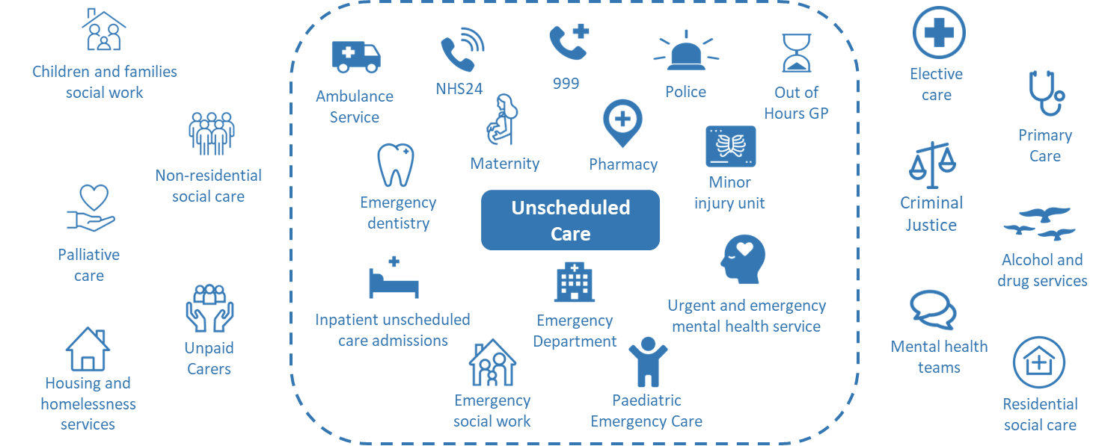
Unscheduled care

Slide 37
Few other things to note

Slide 38
Systems thinking

Slide 39
The spaces between the silos

Slide 40
Thinking as a system does not mean you need to do everything now and everything together.

Slide 41
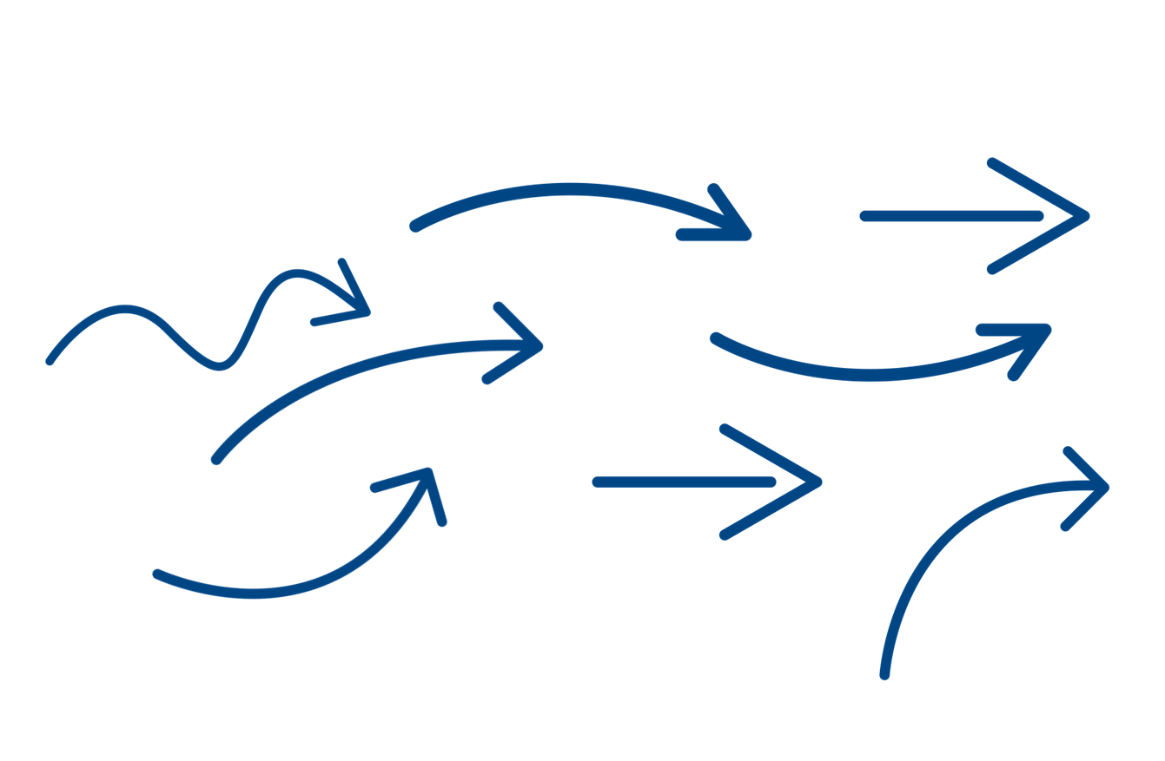
Instead, it means

Slide 42
Being in the same room isn’t system action

Slide 43
Systems thinking in our roles

Slide 44
What can we do with our role?
Start somewhere, go everywhere
Avoid over simplification
Be curious about what is asked of you
Who to bring in matters
Provide challenge
Mapping is just the start
How you frame information
Sign off vs buy in
Look for system impacts

Slide 45
What does systems thinking mean for different roles?

Slide 46
What next?
Notes:
CH

Slide 47
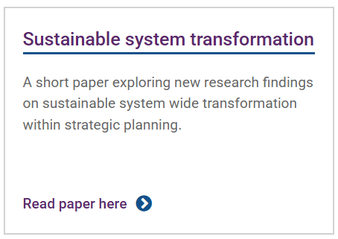
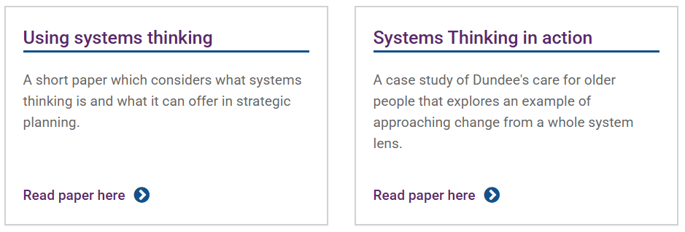
What next?

Slide 48
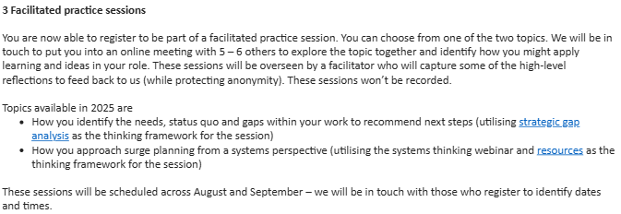
What next?

Slide 49
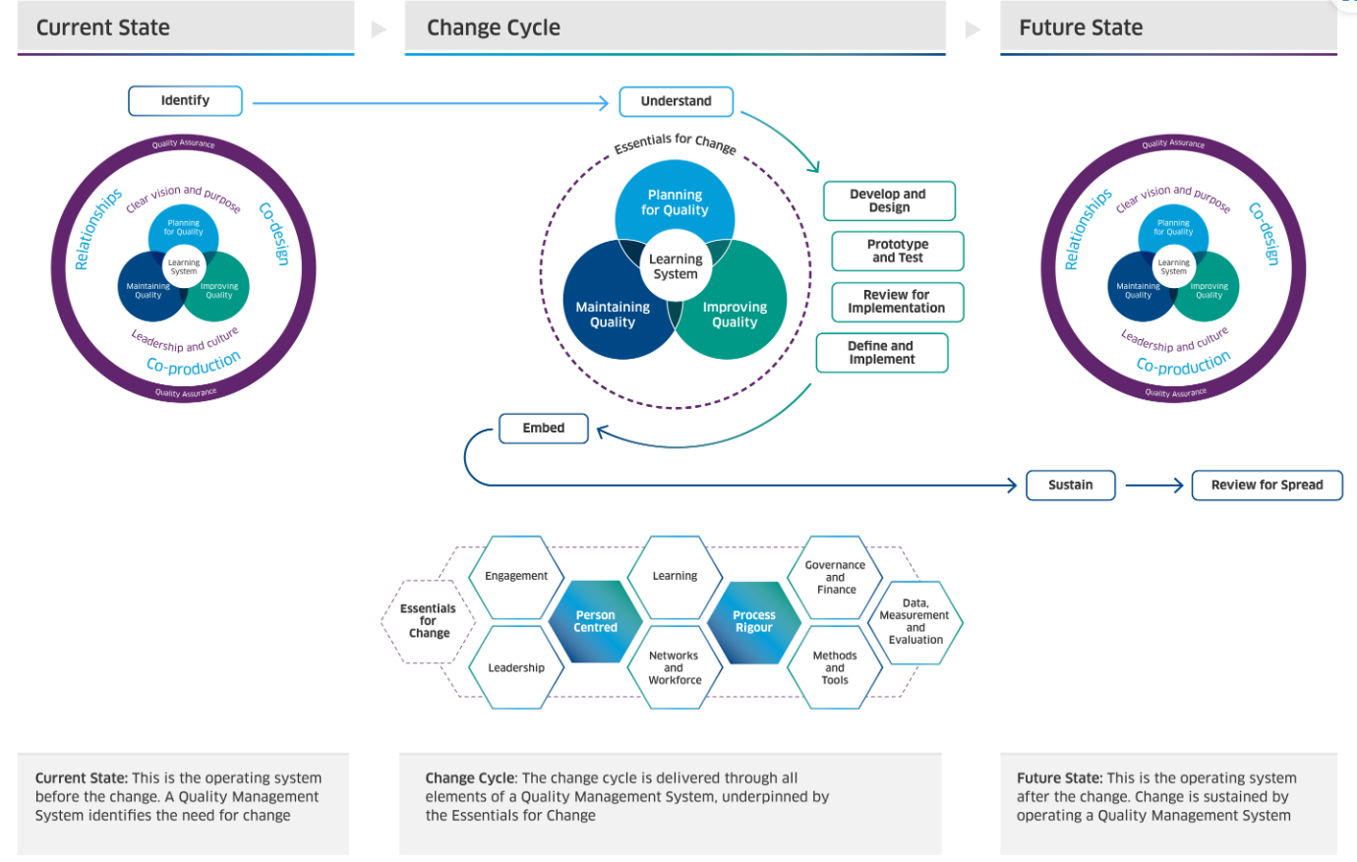
What next?

Slide 50
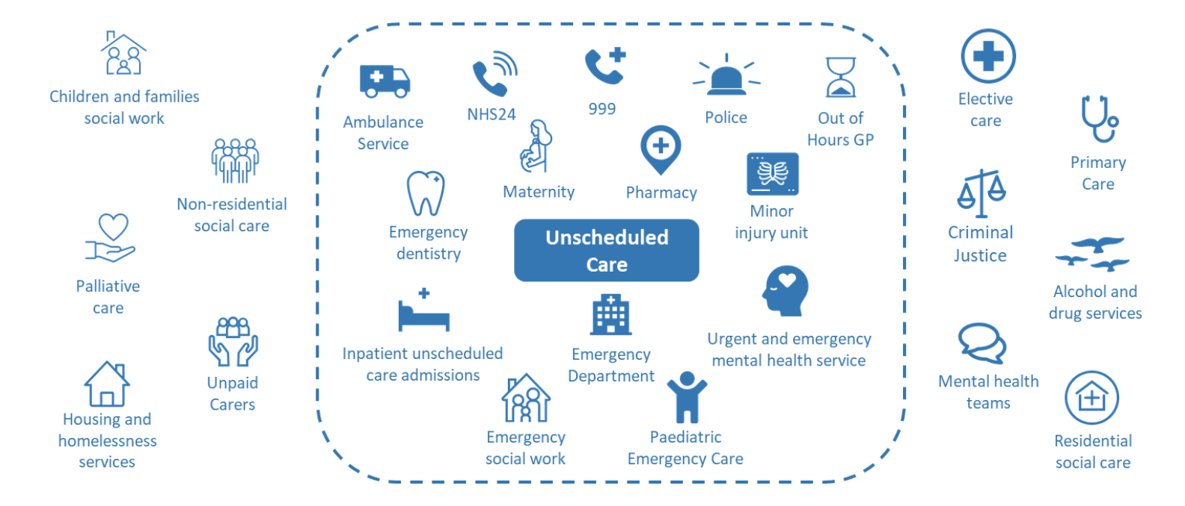
What next?

Slide 51
How to stay connected
Twitter/X: @online_his
Bluesky: @healthimprovescot.bsky.social
Email: transformationalsystemchange@nhs.scot
Web: healthcareimprovementscotland.scot
Leading quality health and care for Scotland

