Slide 1


Adults with Incapacity (AWI)
People’s stories of hospital delays
Produced as part of local improvement work on AWI delayed discharge
Based on field work with staff in Glasgow
June 2025
Leading quality health and care for Scotland

Slide 2
About this research
In 2024, Healthcare Improvement Scotland was commissioned by Scottish Government to undertake local improvement work in Glasgow City, Forth Valley and Dumfries and Galloway to help reduce delays in hospital discharge for people where Adults with Incapacity (AWI) processes are relevant. This support ran from July 2024 until June 2025.
As part of our local work and engagement with national and local stakeholders, we observed that discussions amongst decision makers in relation to AWI delays tended to focus on technical aspects of the process that may be able to be improved. But we felt that there was a gap in the evidence available that articulated the whole experience of the individual person from hospital admission to discharge.
We undertook interviews with consultants, nurses, social workers and mental health officers across different settings and geographies within Glasgow to explore the details of 25 cases of people who had a hospital stay in the past 5 years where AWI processes were at play. We asked interviewees to draw information from their case files to explore key activities and milestones, reflect on the feelings of staff, the person and their loved ones during their stay in hospital. Interviewees anonymised the information they gave us during interviews. We did not gather patient details like name, CHI, or date of birth.

Slide 3
About this research
Following completion of the interviewees we drew on these 25 cases to develop 9 composite stories. This means that we drew together stories with similar themes to change certain details to protect people’s anonymity and increase the level of detail we could provide in the story. We were reliant on information collected within case notes which meant that we didn’t always get complete information for all activities or details for each of the 25 cases. Composite stories enabled us to build fuller stories that we felt were a fair reflection of common experiences and stories of people delayed in hospital where AWI processes were relevant.
We sought to develop stories that covered a wide variety of situations, contexts and health conditions. One gap in our stories is that we do not have a story that represents someone in a mental health ward.
The next two pages outline the limitations to this research so that they can be used with the appropriate caveats.

Slide 4
Limitations of this research
These are not first-person accounts These stories are based on information shared by health and social care professionals. We interviewed staff and gathered information from case notes from 25 separate cases across Glasgow. We have used those 25 cases to develop 9 stories. Each story is made up of more than one case – this enables us to change details to protect anonymity and allow us to produce more complete stories where case note information was limited on some of the 25 cases we explored. We feel that these 9 stories provide a valuable and reliable source of insight into the common experiences of people delayed in hospital where AWI processes are relevant. Lived experience research is underway within Scottish Government by the Office of the Chief Designer which provides additional accounts from the individuals and/or their loved ones.
Focused on hospital timeline The journey maps only highlight events during hospital admission and discharge. Broader life context and events before or after hospitalisation (such as complaints, care home stays) are not included. We have also relied on information available in the case notes of the professional we were interviewing. We have not sought to link the information up with other factors that were not already included in the case notes – such as whether a complaint was made, and whether advocacy was involved.

Slide 5
Limitations of this research
Gaps and opportunities not explored These stories do not seek to identify missed opportunities, implementation gaps or areas for improvement in care planning, coordination, or communication. We recommend that these stories are used to prompt discussions between multidisciplinary teams and encourage the inclusion of third sector, advocacy services and lived experience in these discussions wherever possible.
Limited stakeholder perspectives The words contained in the yellow boxes have been developed based on staff observations of how the patient or their loved ones was feeling. They should not be read as the actual voice of the individual described in the story.
Partial representation of complex journeys While helpful for illustrating system interactions and journey through the hospital process, the visuals offer only a partial view of each person’s experience and may not capture emotional, social, and legal complexities.

Slide 6
How to use this resource
This resource includes 9 slides, each with a composite story of someone who is delayed in hospital where AWI processes were relevant to supporting their discharge from hospital.
These stories can be used by anyone in Scotland. While they reflect data from Glasgow, based on our local and national engagement during our AWI improvement work, they provide a valuable reflection of cases across other parts of Scotland.
These stories can act as discussion aides or ‘anchor’ documents. They are designed to support multidisciplinary operational, management and leadership teams to reflect on together to support decision making around national and local improvement to the way we undertake hospital discharge planning where AWI processes are relevant.
We hope that these stories will be useful for both local decision makers who are designing their operational policies and processes, as well as national decisions makers in the development of legislation, policy and guidance around AWI and hospital discharge planning.

Slide 7
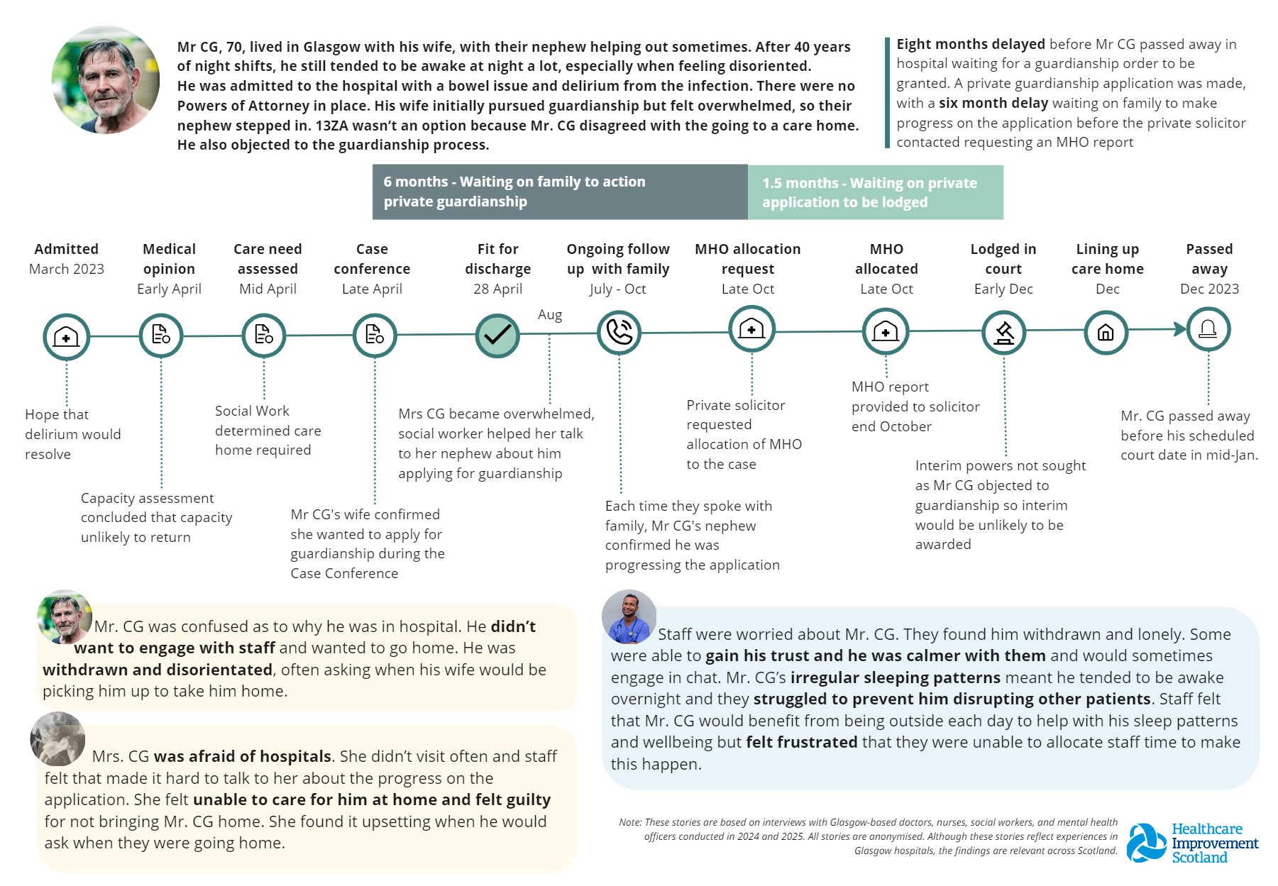

Slide 8
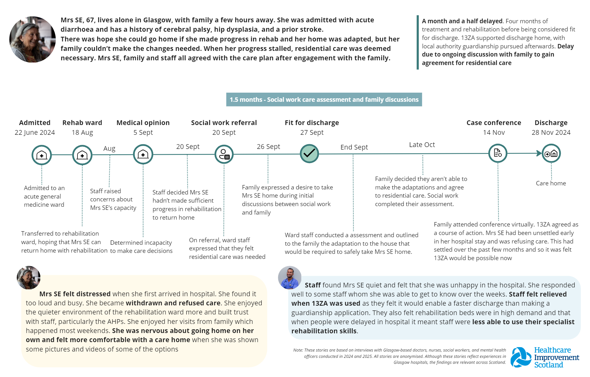

Slide 9
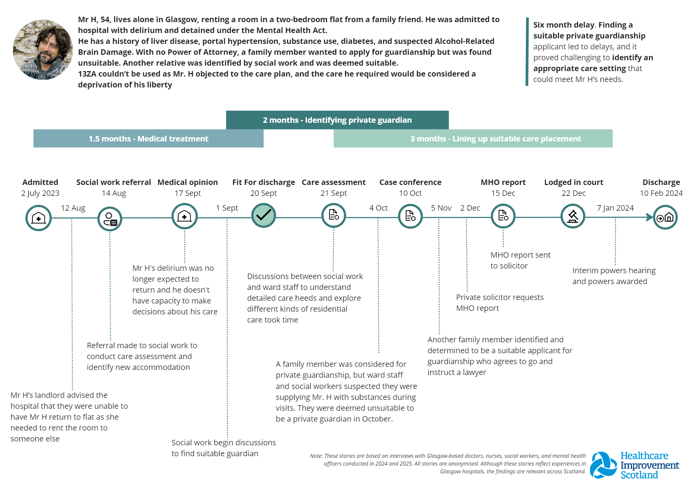

Slide 10
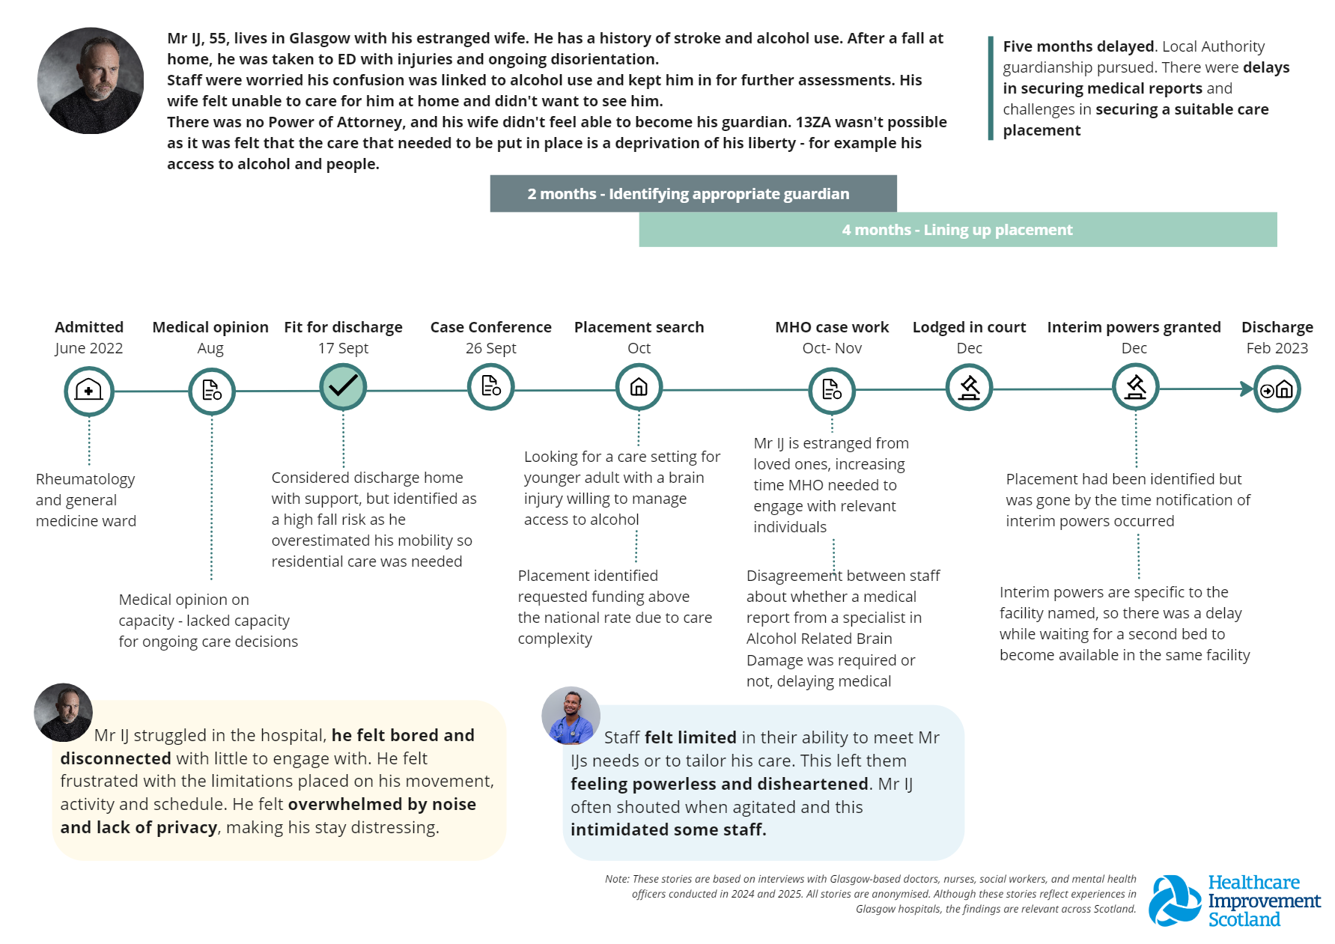

Slide 11
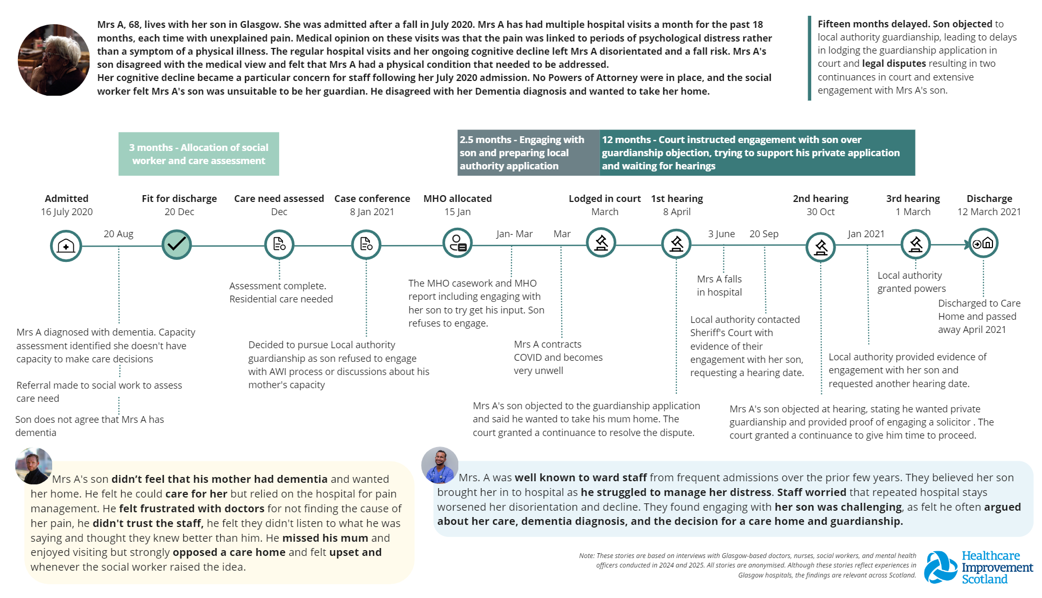

Slide 12
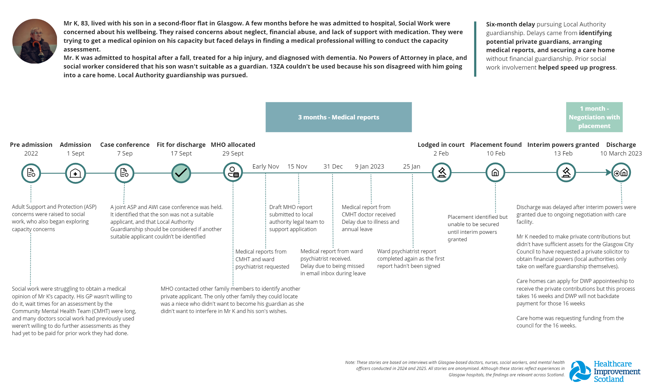

Slide 13
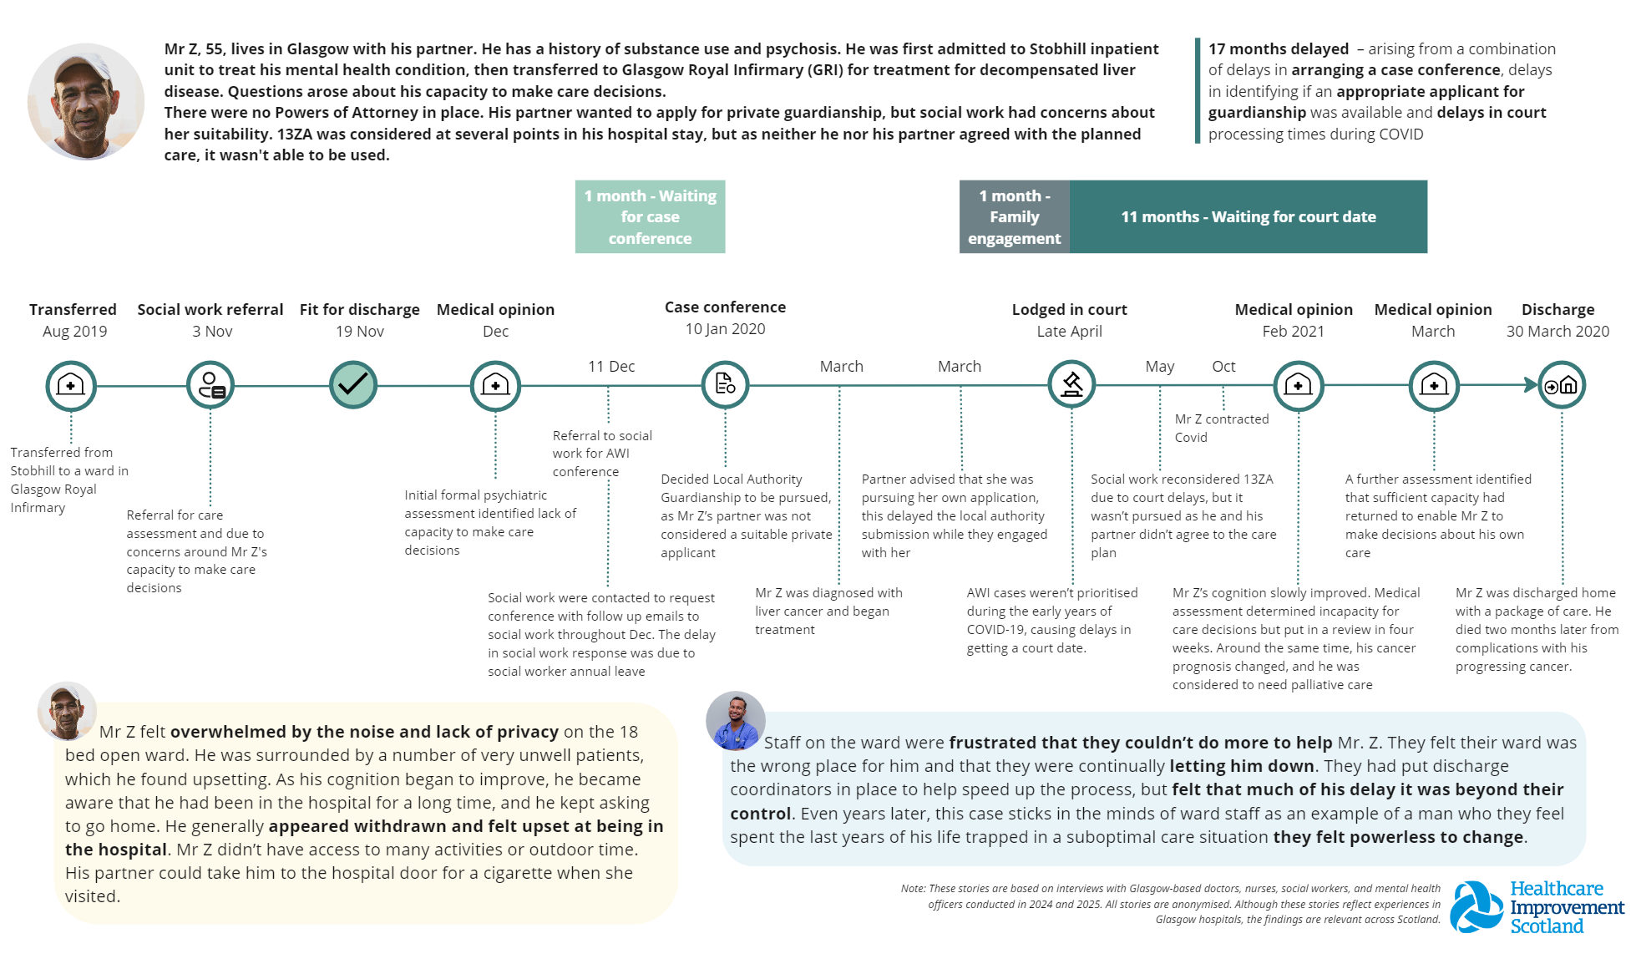

Slide 14
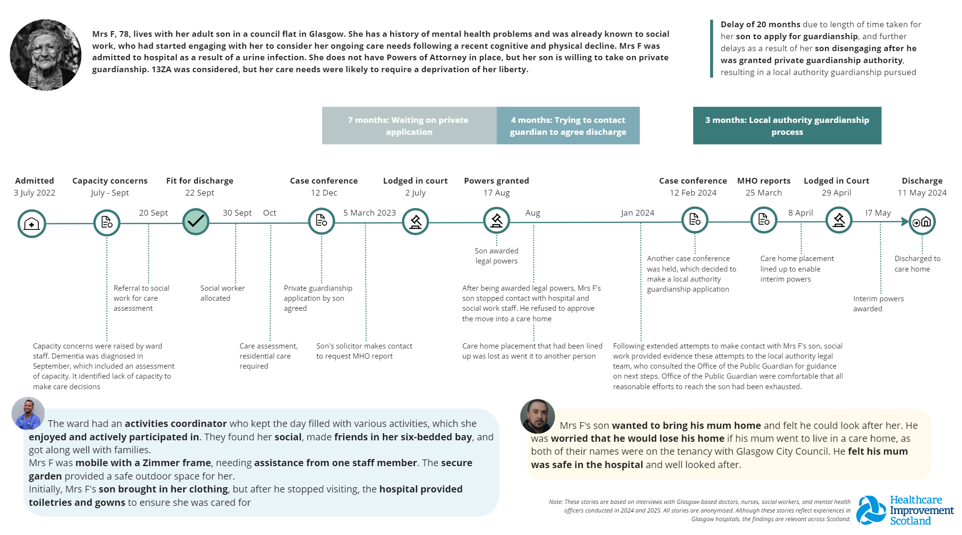

Slide 15
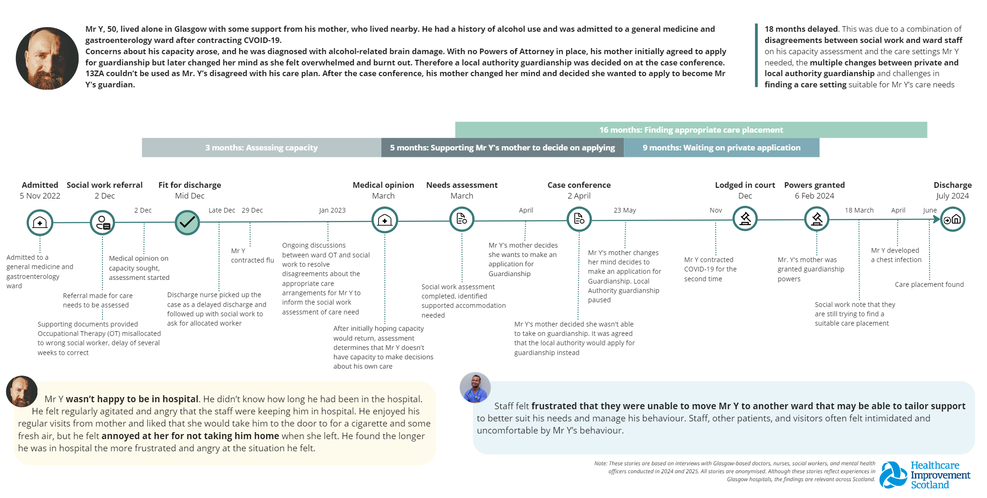

Slide 16
Want more information?
This work was developed by the Healthcare Improvement Scotland, Transformational Change – Systems Unit.
If you want more information, please get in touch.
his.transformationalsystemchange@nhs.scot

