Slide 1


Mental Health and Substance Use
Personas
Supporting better quality health and social care for everyone in Scotland

Slide 2
Agenda
Time | Item
13:30 | Welcomes and Introductions
13:35 | Overview of the programme and updates
13:40 | Personas Review
13:55 | Understanding needs and challenges for engagement
14:10 | Response to needs
14:20 | Next steps and close

Slide 3
Overview of the programme and updates

Slide 4
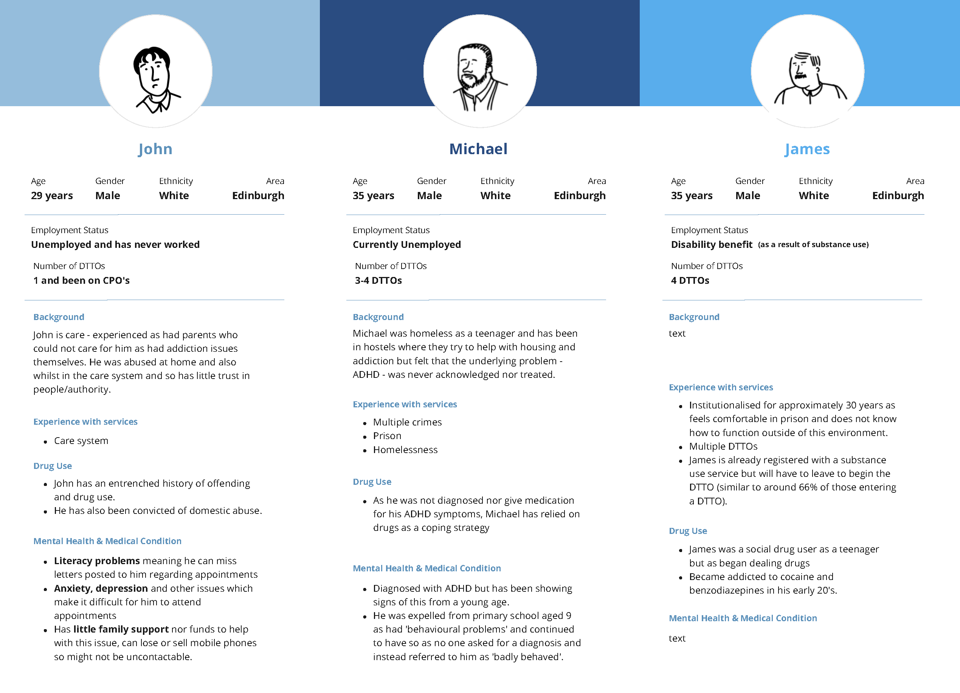
Personas Review

Slide 5
Understanding needs and challenges for engagement
What are the needs of each person presented?
What are the challenges might the person face when interacting with services?

Slide 6
Response to needs
What does ‘good’ look like
Considerations / requirements when designing services for the person
What could be opportunities to improve the service for the person

Slide 7

Next steps

Slide 8
Keep in touch
Twitter: @online_his
Email: comments.his@nhs.scot
Web: healthcareimprovementscotland.org
Blog: blog.healthcareimprovementscotland.org
Supporting better quality health and social care for everyone in Scotland

